Slide 1
Non-Constructible change
2023/03/04

Slide 2
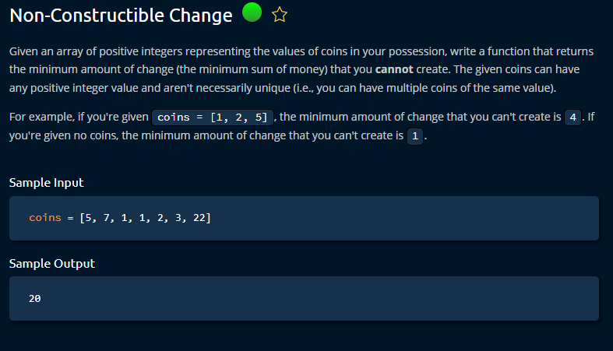

Slide 3
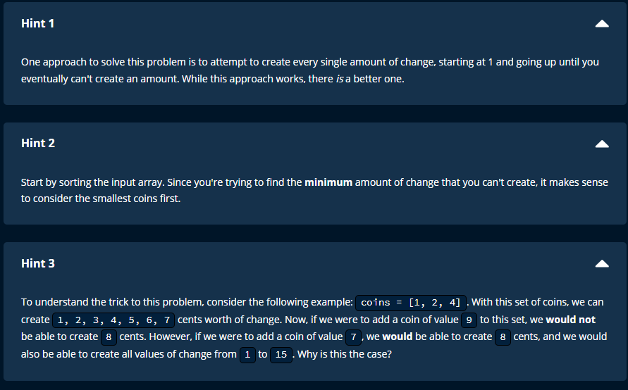

Slide 4
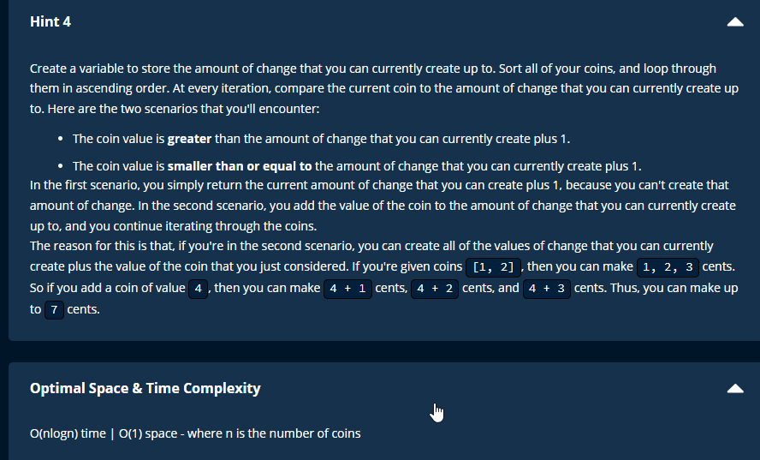

Slide 5
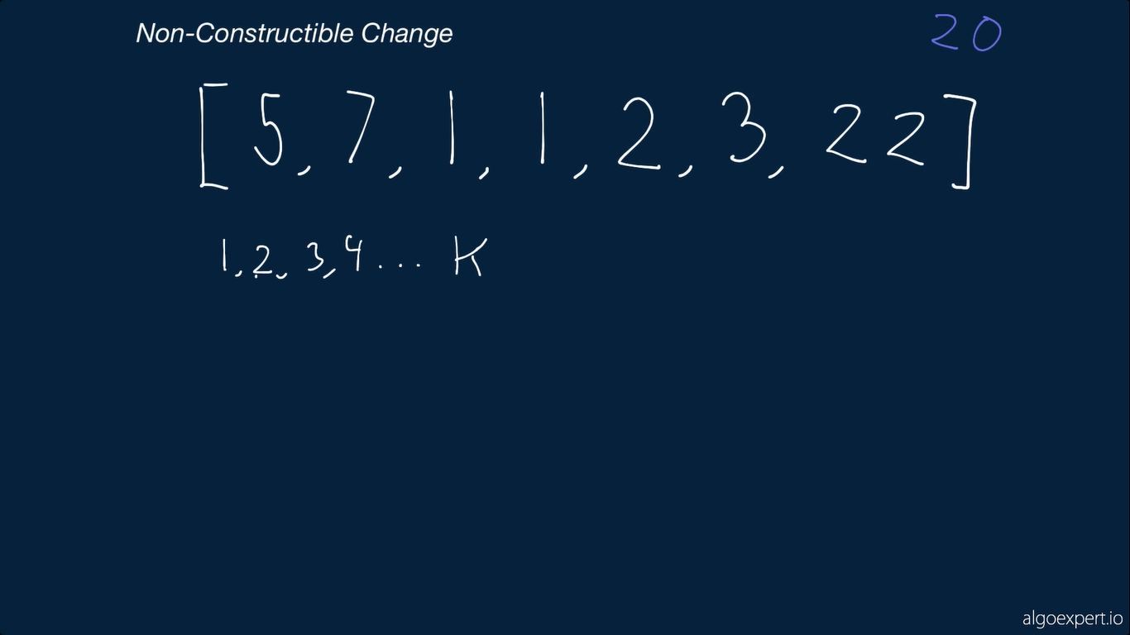

Slide 6
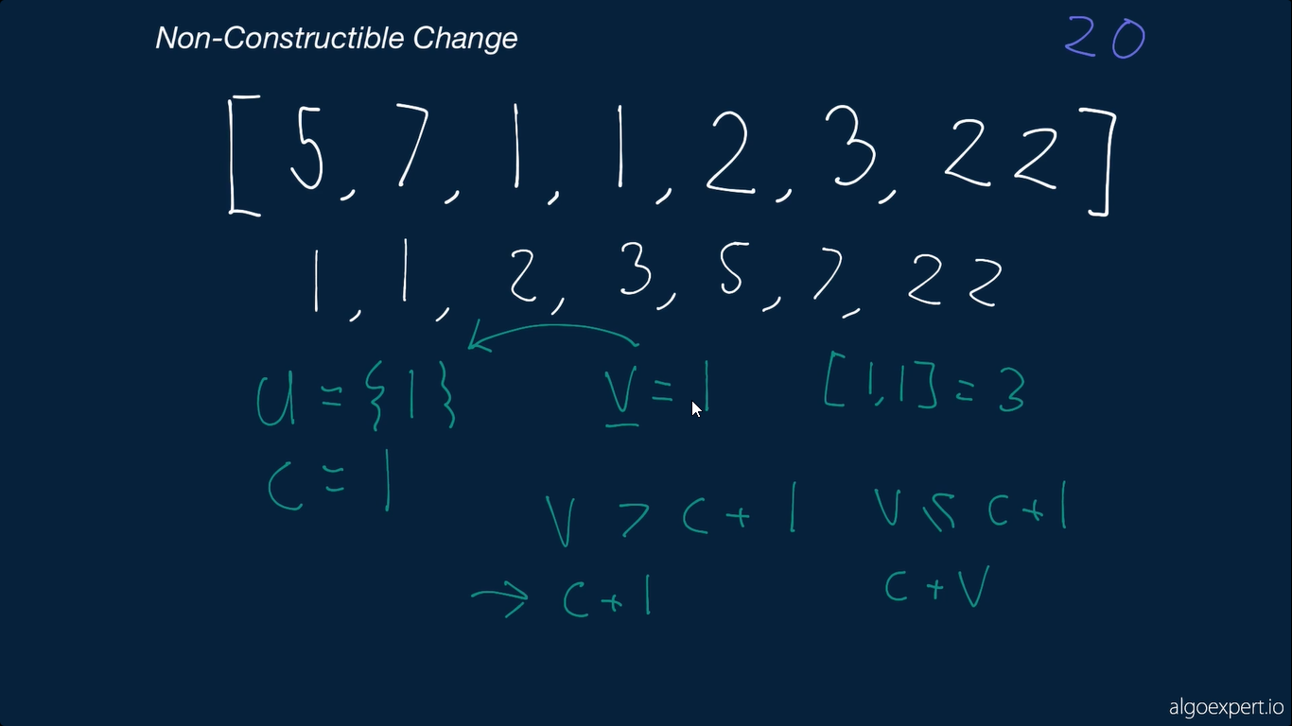

Slide 7
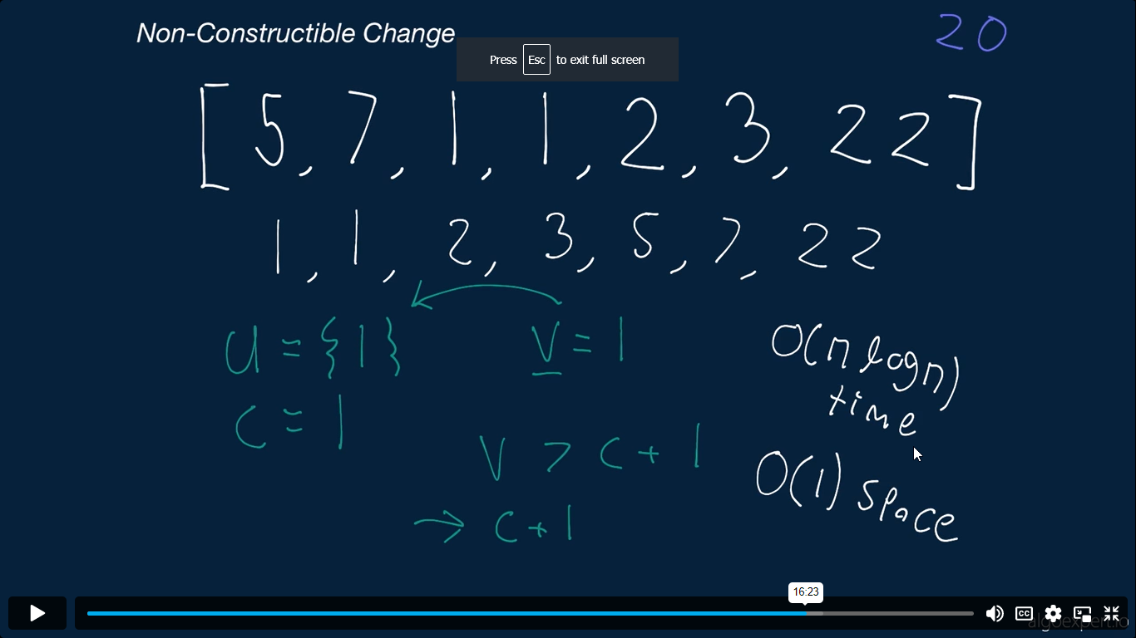

Slide 8
Time and Space Complexity
Time
Sortion = O(nlogn)
Remaining parts = O(n)
Final = O(nlog n)
Space
O(1)
Occur at the same list.

